Slide 1
CMP 2203
LECTURE 5

Slide 2
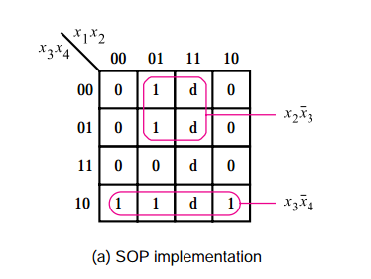
Incompletely Specified Functions
Certain input conditions can never occur in some circuits
We “don’t care” whether their output is LOW or HIGH
Functions with don’t-care conditions are said to be incompletely specified
Choose them to be 0 or 1 in a way that gives the simplest implementation

Slide 3
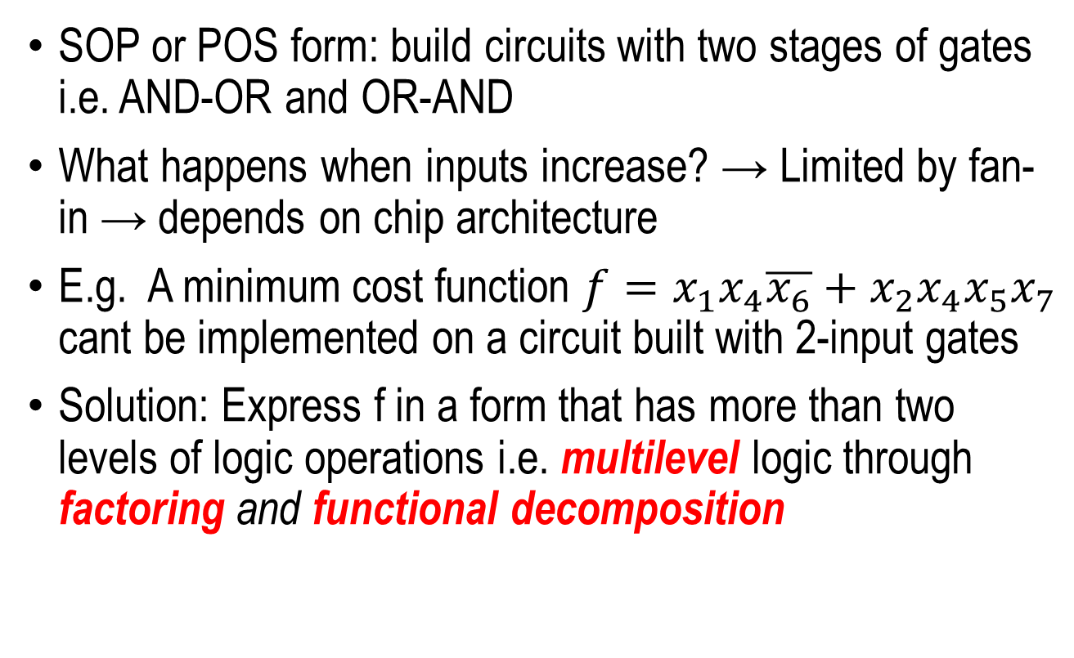
Multi-Level Synthesis

Slide 4
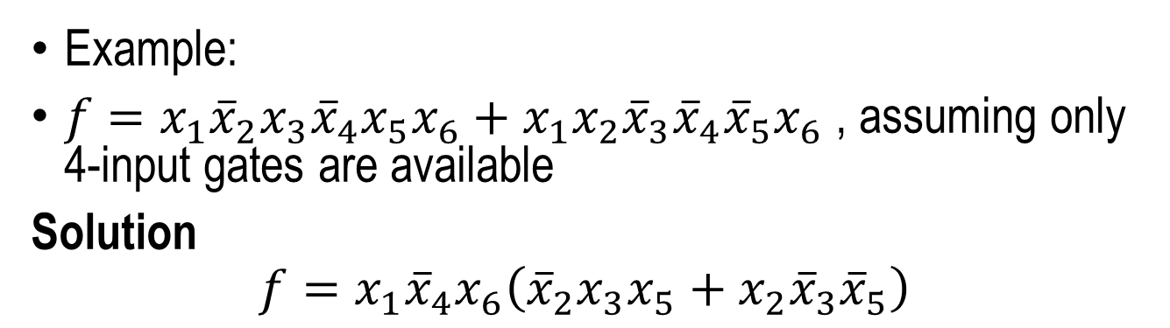
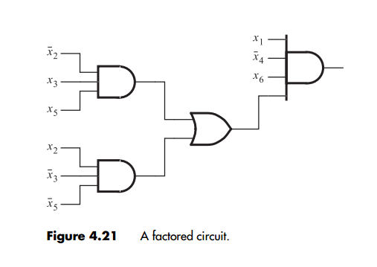
Factoring
Use 3 AND gates and 1 OR gate

Slide 5
Functional Decomposition
Decompose a two-level circuit into sub circuits
Sub circuits can be used in several places to create the entire circuit
E.g.
4 AND gates, 1 OR gate , 2 NOT gates.
Fan-in is 3 and 4 for AND gates and OR gate respectively
18 inputs ( wires) to all gates
Wiring takes large chip area. Need to reduce it.

Slide 6
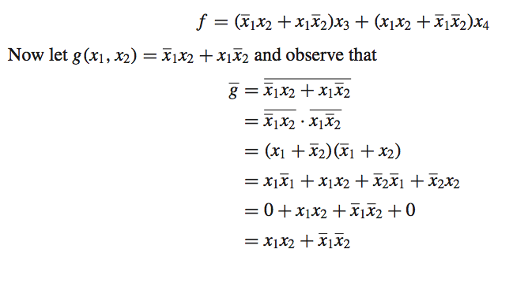
Functional Decomposition

Slide 7
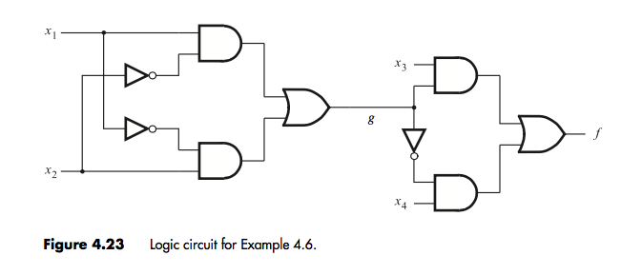
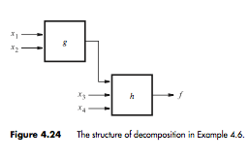
Functional Decomposition
Decomposed realization of f !!
2 additional gates (NOT and OR) but 15 inputs
Reduced biggest fan-in to 2
Cheaper circuit than previous 2 level one
Increased propagation delay ➔ trade-off!

Slide 8
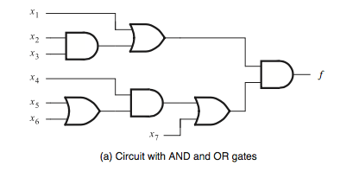
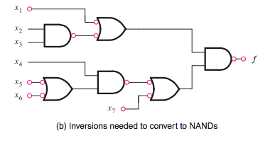
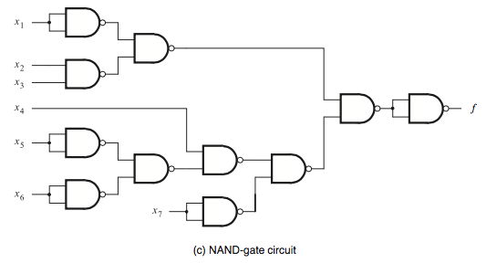
Multi-Level NAND and NOR circuits
=
AND to NAND – invert output
OR to NAND – invert inputs (Lecture 3! Apply De Morgan’s)
Observe inversion on both ends of wire
Implement single inversions (NOT)
SOP = NAND-NAND
POS = NOR-NOR
=

Slide 9
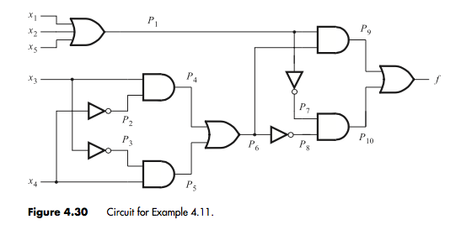
Analysing Multi-level Circuits
Get output at intermediate points and combine to SOP
Work this out. How many gates?

Slide 10
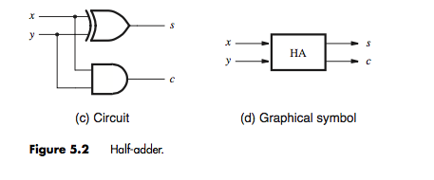
Arithmetic Functions: Half- Adder
Addition of unsigned numbers
Half-adder adds two bits
Output is sum (LSB) and carry (MSB)
x | y | Carry | sum
0 | 0 | 0 | 0
0 | 1 | 0 | 1
1 | 0 | 0 | 1
1 | 1 | 1 | 0
What gates represent the carry and sum?

Slide 11
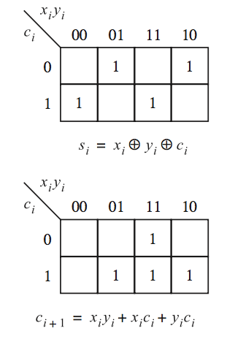
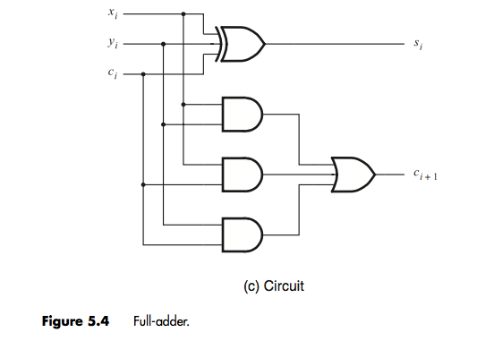
Full-Adder
How do we add more than two bits?
For each bit position, sum involves 3 bits: x_{i},y_{i} and carry-in c_{i}
Output is sum s_{i} and carry-out c_{i+1}
c_{i} | x_{i} | y_{i} | c_{i+1} | s_{i}
0 | 0 | 0 | 0 | 0
0 | 0 | 1 | 0 | 1
0 | 1 | 0 | 0 | 1
0 | 1 | 1 | 1 | 0
1 | 0 | 0 | 0 | 1
1 | 0 | 1 | 1 | 0
1 | 1 | 0 | 1 | 0
1 | 1 | 1 | 1 | 1

Slide 12
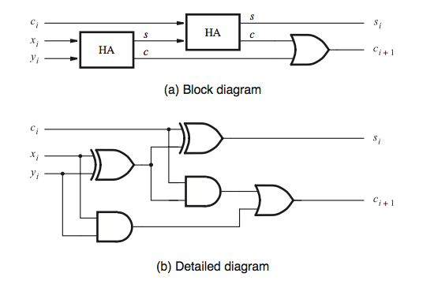
Decomposed Full Adder
Combines 2 half adders to form a full adder
Verify equivalence at home!

Slide 13
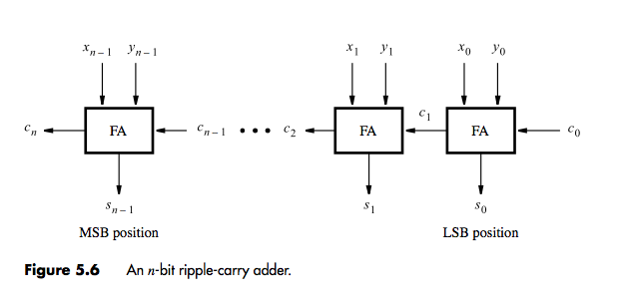
Ripple Carry Adder
Multiple full adders in series
Each adder implements addition of one bit position
Each introduces a delay
Total delay is nΔt

Slide 14
Adder/Subtractor
Recall 2’s complement: flip all bits ( 1’s complement) and add 1
1’s complement : can be done with NOT gates
Addition of 1 can be done by setting initial carry bit i.e. c₀ to 1
More flexibility if we can apply a control input to select true value or complement of each bit using XOR gates
Recall: 2 input XOR gate
We can use e.g. x as a control:

Slide 15
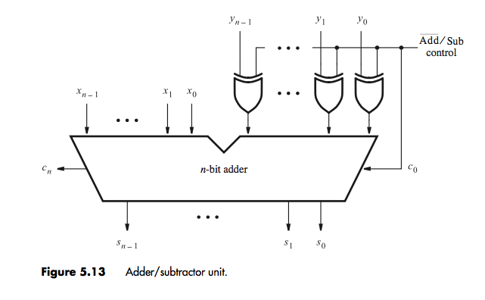
Adder/Subtractor
Choose control signal Add/subtract: If 0 = Add and if 1= subtract
Add/subtract also becomes initial carry bit
Connect each y output to XOR gate and control signal to select true or complement
N-bit full adder

Slide 16
Homework!
Carry Look ahead adder
Multipliers
Dividers

Slide 17
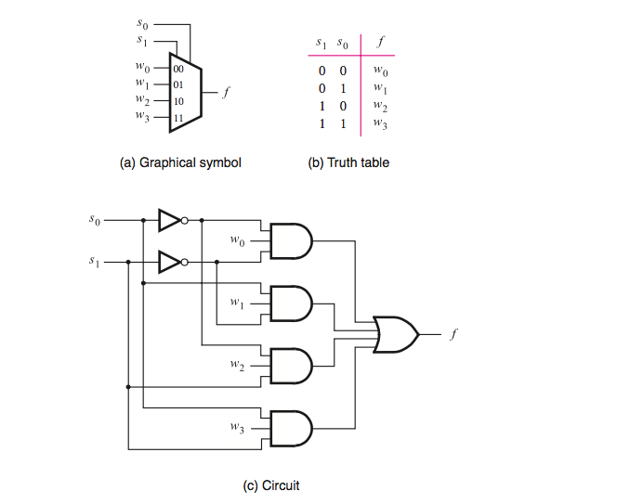
Multiplexers
N data inputs
Log₂N select inputs
Output is one of data inputs depending on value of selector e.g. 4 to 1 multiplexer

Slide 18
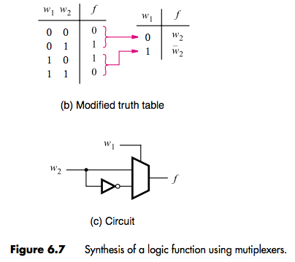
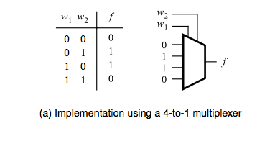
Synthesis of Functions using Multiplexers
Can be implemented with 4-to-1 multiplexer ; connect possible outputs to multiplexer input. Output selected based on value of w1 and w2
OR simplified to 2-to-1 by recognizing a pattern
Can be applied to synthesize any other logic circuit

Slide 19
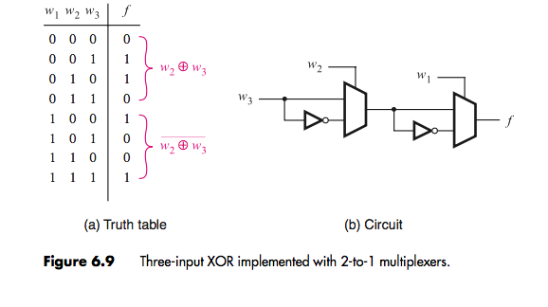
Example 2
Consider truth table for
Homework: when would you use multiplexers?

Slide 20
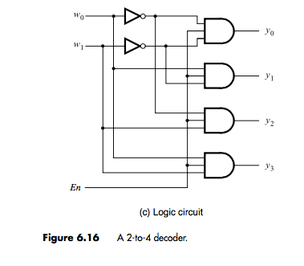
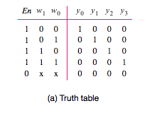
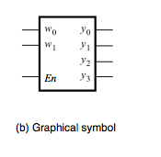
Decoders
Homework: when would you use a decoder?
Decode encoded information
Has n inputs and 2^{n} outputs
Selects only 1 output for each combination of inputs
Also has enable input used to disable the outputs. If En =0, no output is selected irrespective of value of select inputs. If En=1 one output is selected depending on input combination

Slide 21
Demultiplexers
Opposite of multiplexer
Takes one input and places it onto multiple data outputs
Can be implemented with decoder
An n to 2^{n} decoder can be used as a 1- to – n de-multiplexer
En is the data input and outputs are y0 to yn
Selection of w0w1 determines which of the outputs is set to En

Slide 22
Continuous Assessment Test One
Material up to Lecture 6
Thursday 15th March, 10.00 AM
Closed Book
Zero tolerance to cheating
Missing the test = no grade. No exceptions
Good Luck!

Slide 23
Handout
Read Chapter 5 and 6 of Brown

